Slide 1
Employee Data Analysis Using excel
Name: P. Anbu selvan
Register: user id asunm110312201225
Department: III Bcom (general)
College: D. R. B. C. C. C hindhu college, pattabiram

Slide 2
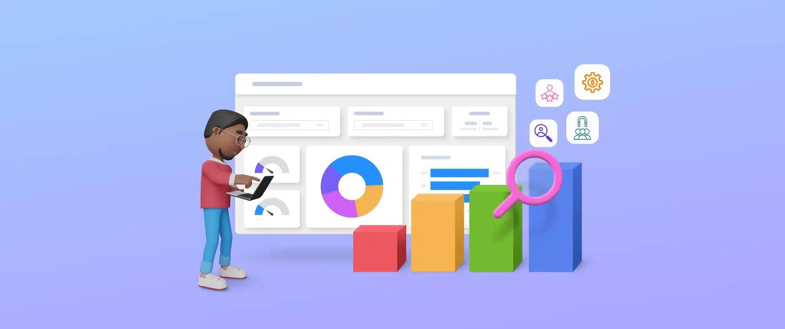
Project Title
Employee type analysis excel & employee salary analysis using excel

Slide 3
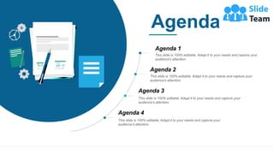
Ajenda
Problem Statement
Project overview
End users
Our solution & preposition
Dataset description
Modling approach
Result and discussion
Conclusion

Slide 4
Problem statement
1. Data visualization and reporting Pivot tables and data modeling.VLOOKUP and INDEX-MATCH functions.Data analysis and interpretation. Chart creation and formatting. Data manipulation and cleaning. Macro creation and automation
1. Programming languages (e.g., Python, R)2. Data science tools (e.g., Tableau, Power BI)3. Statistical knowledge (e.g., regression, hypothesis testing)4. HRIS systems (e.g., Workday, BambooHR)

Slide 5
Project overview
_Deliverables:_1. _Cleaned and Processed HR Data_: - Formatted and organized datasets - Removed duplicates and errors - Handled missing values and outliers - Documented data sources and processing steps2. _Automated Data Analysis and Reporting Workflows_: - Developed Python or R scripts for data analysis and reporting - Created automated dashboards and reports3. _Statistical Models and Analyses_: - Conducted regression analysis for predictive modeling - Performed hypothesis testing for insights and trends - Applied statistical techniques for data analysis 4. _Interactive Visualizations and Dashboards_: - Designed and developed interactive dashboards using Tableau or Power BI

Slide 6
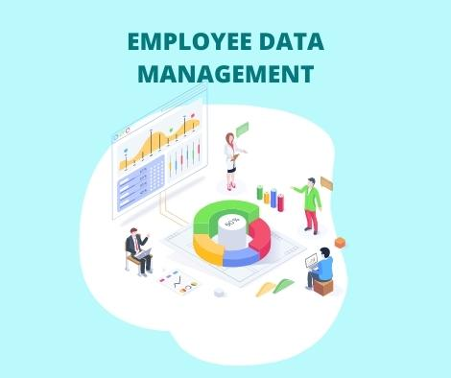
Who are the end users?
These end users will benefit from the project’s deliverables, including: - Cleaned and processed HR data - Automated data analysis and reporting workflows - Statistical models and analyses - Interactive visualizations and dashboards

Slide 7
Who are the end users?
1. *HR Business Partners*: HR professionals who work closely with business leaders to inform workforce decisions.2. *HR Managers*: Managers responsible for HR operations, talent management, and employee engagement.3. *Talent Acquisition Team*: Recruiters and hiring managers who need data-driven insights to optimize recruitment strategies.4. *Learning and Development Team*: Professionals responsible for employee training and development programs.5. *Compensation and Benefits Team*: Analysts and managers who design and administer employee compensation and benefits packages.

Slide 8
Our solution and value preposition
Our solution enables HR professionals and business leaders to:1. *Make Data-Driven Decisions*: With accurate, timely, and actionable insights.2. *Optimize HR Processes*: By identifying areas for improvement and streamlining operations.3. *Improve Workforce Management*: Through better talent acquisition, development, and retention strategies.4. *Enhance Employee Experience*: By identifying and addressing employee engagement, satisfaction, and skill gaps.5. *Drive Business Outcomes*: By aligning HR strategies with business objectives and metr

Slide 9
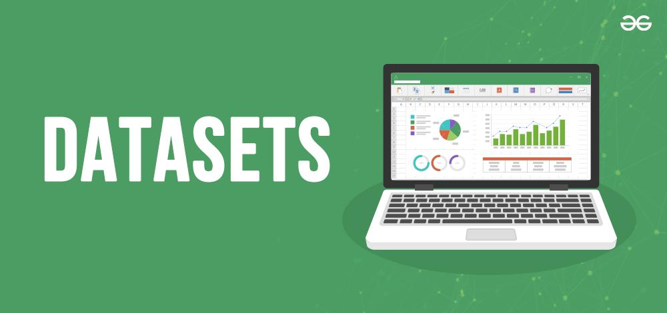
Dataset description
*Data Quality:*- Cleaned and processed to ensure accuracy and consistency- Handles missing values and outliers- Documented data sources and processing steps
*Data Sources:*- HR Information System (HRIS)- Talent Management System- Recruitment Management System- Learning Management System- Benefits Administration System

Slide 10
Modeling approach
_Modeling Approach:_1. _Descriptive Analytics:_ Explore and summarize the dataset to understand employee demographics, job information, talent management, recruitment, training, and benefits.2. _Inferential Analytics:_ Apply statistical methods to identify trends, patterns, and correlations within the data.3. _Predictive Analytics:_ Develop models to forecast future outcomes, such as: - Employee turnover and retention - Job openings and time-to-hire - Training effectiveness and skill gaps - Benefits utilization and cost management4. _Prescriptive Analytics:_ Use optimization techniques to recommend HR strategies and interventions, such as:

Slide 11
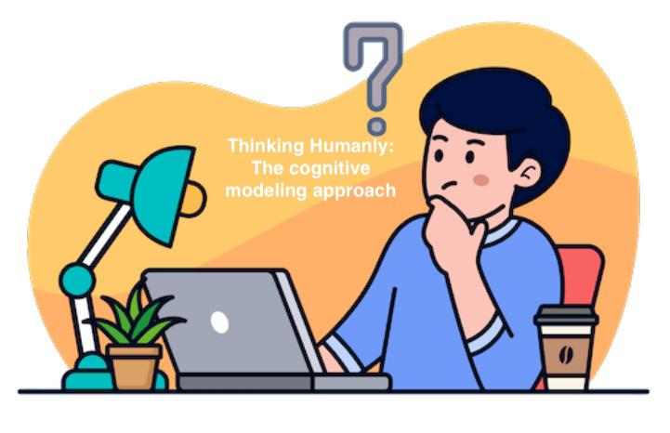
Modeling approach
1. _Descriptive Analytics:_ Explore and summarize the dataset to understand employee demographics, job information, talent management, recruitment, training, and benefits. 2. _Inferential Analytics:_ Apply statistical methods to identify trends, patterns, and correlations within the data. 3. _Predictive Analytics:_ Develop models to forecast future outcomes, such as: - Employee turnover and retention - Job openings and time-to-hire - Training effectiveness and skill gaps - Benefits utilization and cost management 4. _Prescriptive Analytics:_ Use optimization techniques to recommend HR strategies and interventions, such as:

Slide 12
Results
PR00147 | Minerva Ricardot | Male | NULL | 105468.7
PR04686 | Oona Donan | Female | Business Development | 88360.79
SQ04612 | Mick Spraberry | Female | Services | 85879.23
VT01803 | Freddy Linford | Female | Training | 93128.34
TN02749 | Mackenzie Hannis | Female | Training | 57002.02
SQ00144 | Collen Dunbleton | Male | Engineering | 118976.16
PR04601 | Nananne Gehringer |  | Support | 104802.63
SQ01854 | Jessica Callcott | Female | Marketing | 66017.18
SQ00612 | Leena Bruckshaw | Male | Research and Development | 74279.01
PR00419 | Billi Fellgate | Female | Business Development | 68980.52
VT00578 | Magnum Locksley | Female | Services | 42314.39
TN01281 | Cletus McGarahan | Female | Engineering | 114425.19
PR04473 | Wyn Treadger | Female | Business Development | 69192.85
VT02417 | Evangelina Lergan | Male | Support | 61214.26
SQ00691 | Verla Timmis | Male | Support | 54137.05
TN00214 | Jo-anne Gobeau | Female | Training | 37902.35
VT02539 | Devinne Tuny | Male | Engineering | 39969.72
SQ04598 | Pearla Beteriss | Male | Services | 69913.39
TN00464 | Maritsa Marusic | Male | Research and Development | 52748.63
PR00893 | Daisie McNeice | Male | Human Resources | 50310.09

Slide 13

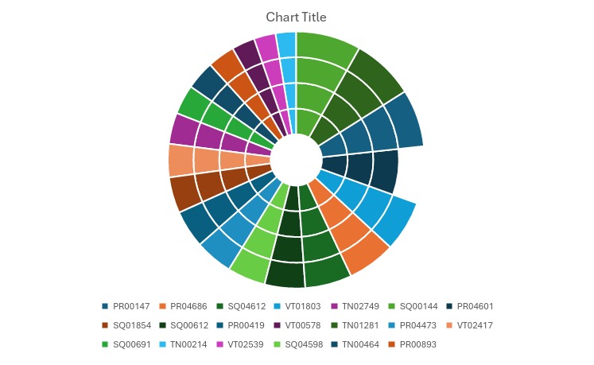
Results

Slide 14

Discussion
*1. *Refine the Model*: Continuously iterate and refine the model to incorporate new data, feedback, and evolving HR priorities.2. *Stakeholder Engagement*: Collaborate with HR stakeholders to ensure the model aligns with their needs and priorities.3. *Implementation and Monitoring*: Implement the recommended HR strategies and interventions, monitoring their effectiveness and adjusting the moving

Slide 15

Conclusions
1. Descriptive Analytics: Understanding employee demographics, job information, talent management, recruitment, training, and benefits.2. Inferential Analytics: Identifying trends, patterns, and correlations within the data.3. Predictive Analytics: Forecasting future outcomes, such as employee turnover, job openings, training effectiveness, and benefits utilization.4. Prescriptive Analytics: Recommending HR strategies and interventions, including talent development, recruitment source optimization, training program design, and benefits package design.

